Slide 1
Analysing perception of the effectiveness of the Criminal Justice System using CSEW
Dr Ana Morales-Gomez
Research Associate
UK Data Service
Twitter: @A_moralesgomez
Manchester
4-5 February 2020

Slide 2

It all start with a question
Factors associated to the Confidence of the criminal Justice System
What are the factors associated with higher levels of confidence in the CJS?

Slide 3
Criminal Justice System (England and Wales)
Police
The Crown Prosecution Service (43 police forces E&W)
The courts, HM Courts & Tribunals Service (HMCTS)
The Ministry of Justice
The Home Office
The Attorney General Office
Her Majesty’s Prison & Probation Service
The Crown Prosecution Service &
Her Majesty’s Crown Prosecution Service Inspectorate (HMCPSI)
Notes:
The Criminal Justice System covers England and Wales and is one of the major public services in this country
The Home Office is the lead government department for immigration and passports, drugs policy, crime, fire, counter-terrorism and police.
The Crown Prosecution Service (CPS) prosecutes criminal cases that have been investigated by the police and other investigative organisations in England and Wales. The CPS is independent, and we make our decisions independently of the police and government.
(HMCPSI) inspects the work carried out by the CPS and other prosecuting agencies

Slide 4
Confidence and the Effectiveness of the CJS
Effective justice systems protect the rights of all citizens against infringement of the law by others, including by powerful parties and governments (OECD, 2017).
Trust and fairness also associated with confidence
Effectiveness may be perceived differently according to the different CJS agencies
- Effectiveness of the Courts
- Effectiveness of prisons
- Effectiveness of the police
Confidence in the effectiveness and fairness of the CJS is mixed, and varies according to demographic factors, as well as the type of involvement. (Sentencing Council, 2019)
Notes:
effective criminal justice systems are capable of investigating and adjudicating criminal offences effectively and impartially, while ensuring that the rights of suspects and victims are protected
People might be confident that the police is effective at catching criminal, but not so sure about the effectiveness of prison in reha

Slide 5
“Predictors”
Involvement:
Victims of crime or witnesses of certain types of crime were less likely to have confidence in the CJS than those who had not
Those who reported having committed theft, vandalism or violence since the age of 16 were less likely to have confidence in the CJS than those who had not.
Demographics:
Gender
Age
Ethnic group
Income / level of neighbourhood deprivation
Notes:
Higher deprivation in neighbourhood, higher level of confidence

Slide 6

Where to start?
Data:
- Quantitative, qualitative (not covering here)
- Collecting our own data (expensive, long process, ethics, cumbersome)
- Using secondary data : CSEW, SCJS, etc

Slide 7

How to start?
Analytical model
- Capture the complexity of the topic:
theory, literature review
- Capture the complexity of the data
Different type of variables (continuous, binary, nominal, etc)
Fact measures facts: Age, ethnic groups, etc.
Subjective measures: opinion, perceptions, believes, etc

Slide 8
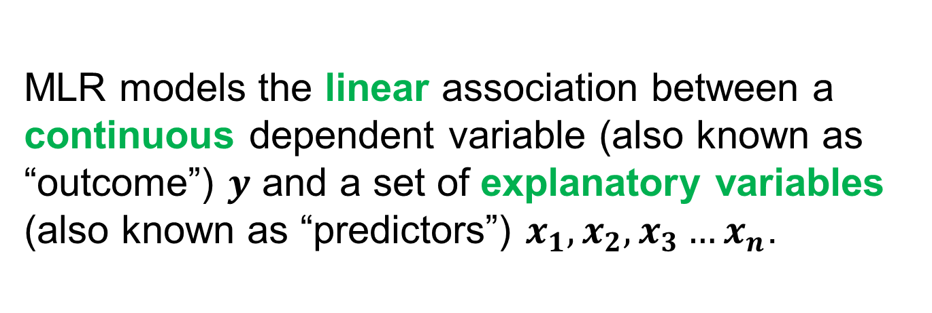
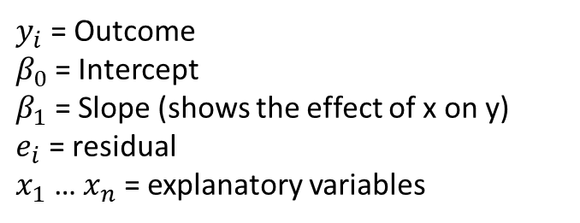
Multiple Linear Regression: A practical application
MLR models the linear association between a continuous dependent variable (also known as “outcome”) $y$ and a set of explanatory variables (also known as “predictors”) $x_{1}, x_{2},x_{3}…x_{n}$.
$$y_{i}=β_{0}+β_{1}x_{i1}+…+β_{n }x_{in}+e_{i}$$
$y_{i}$ = Outcome
$β_{0}$= Intercept
$β_{1}$ = Slope (shows the effect of x on y)
$e_{i}$ = residual
$x_{1}$ … $x_{n}$ = explanatory variables
Notes:
B1 shows estimated effect of X1 on Y, while controlling for Xn: Bn shows the effect of Xn on Y, while controlling for X1

Slide 9
Multiple Linear Regression: A practical application
This analysis does not allow us to make causal inferences, but it does allow us to investigate how a set of explanatory variables is associated with a dependent variable of interest.
Examples
Estimate students’ performance
Estimate the confidence in the police

Slide 10

Brief: Simple Linear regression
Predicts the value of a continuous dependent variable y and a single explanatory variable x
Example: Predicting dragons’ weight given their heights
pattern | weight | height
striped | 4.2 | 5.1
spotted | 3.5 | 43
spotted | 3.8 | 5.5
striped | 5.1 | 5.9
Dragons: © Allison Horst

Slide 11
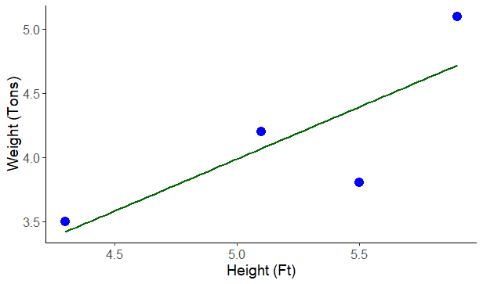

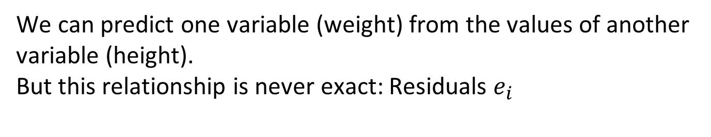
Predicting dragons’ weight given height
We can predict one variable (weight) from the values of another variable (height).
But this relationship is never exact: Residuals $e_{i}$
Dragons: © Allison Horst
Notes:
Aim: to find a straight line to summarise the relationship between the dependent and independent variables
We can see that there is a positive correlation: the taller the dinosaurs the heavier it will be
But, this relationship is never exact
Intercept:
Where the straight line intersects the y-axis.
Slope/ gradient:
Equals the change in y for a one-unit increase in x
Σ[e_{i}]² - the ‘sum of squared residuals’
the line that minimises ‘the sum of squared residuals’

Slide 12
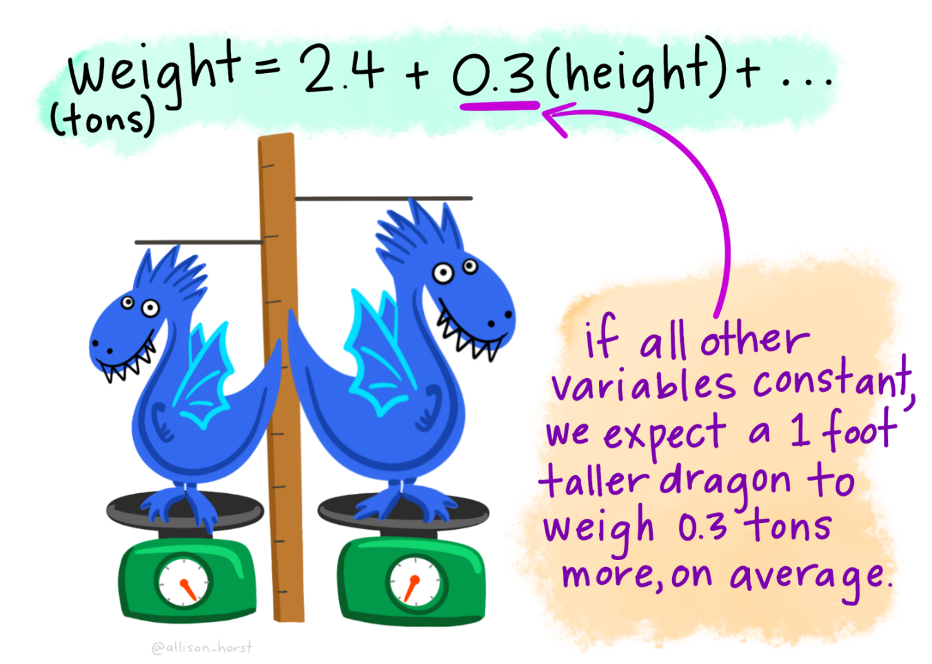
Predicting dragons’ weight given heights
Interpretation of continuous explanatory variable: height in tons
 | Estimate
(Intercept) | 2.4
height | 0.3
Dragons: © Allison Horst

Slide 13
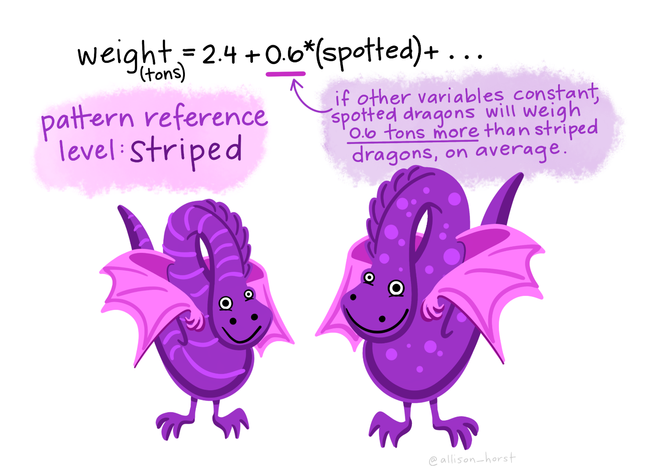
Predicting dragons’ weight given height and pattern
Interpretation of binary explanatory variable: Patter (0= striped and 1= spotted)
Coefficients:
 | Estimate
(Intercept) | 2.4
height | 0.3
pattern: spotted | 0.6
Dragons: © Allison Horst
Notes:
With categoric variables, we always compare the estimate to the one from the reference category

Slide 14
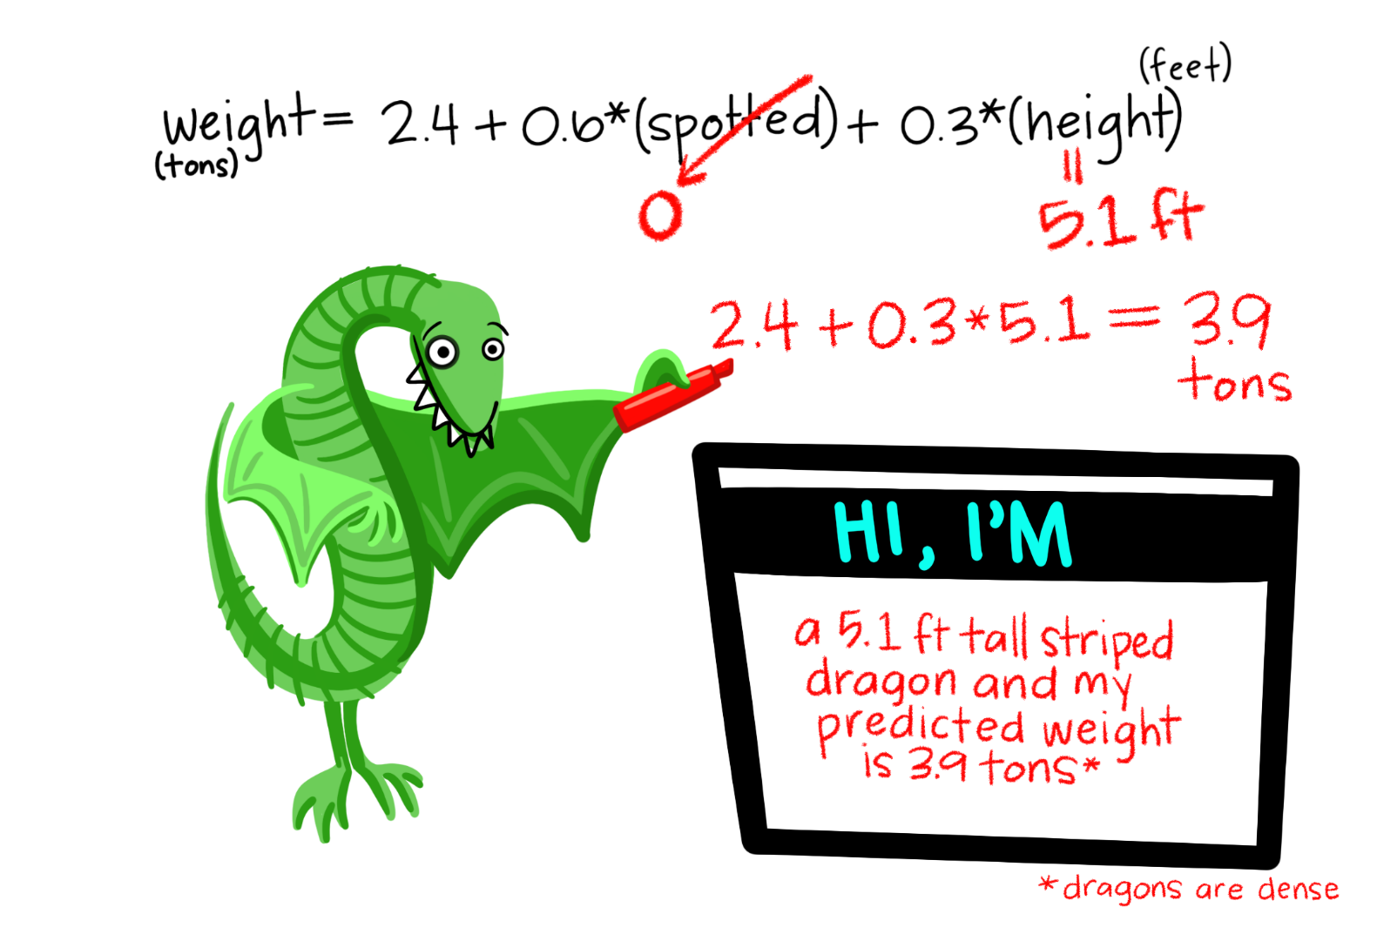
Predicting dragons’ weight given height and pattern
Predicted value for weight (y): 3.9 tons
Dragons: © Allison Horst

Slide 15
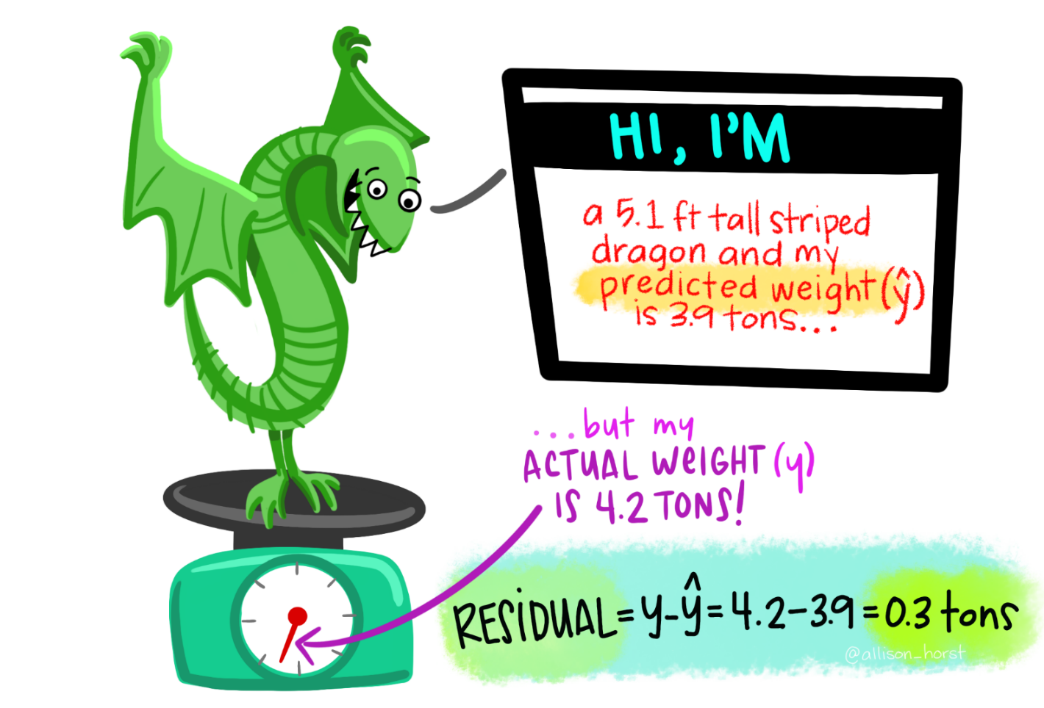
Predicting dragons’ weight given height and pattern
Residual (e): The difference between the actual value of y_{i} and the predicted y̅_{i}
Dragons: © Allison Horst
Notes:
But, this predicted value is never exact

Slide 16
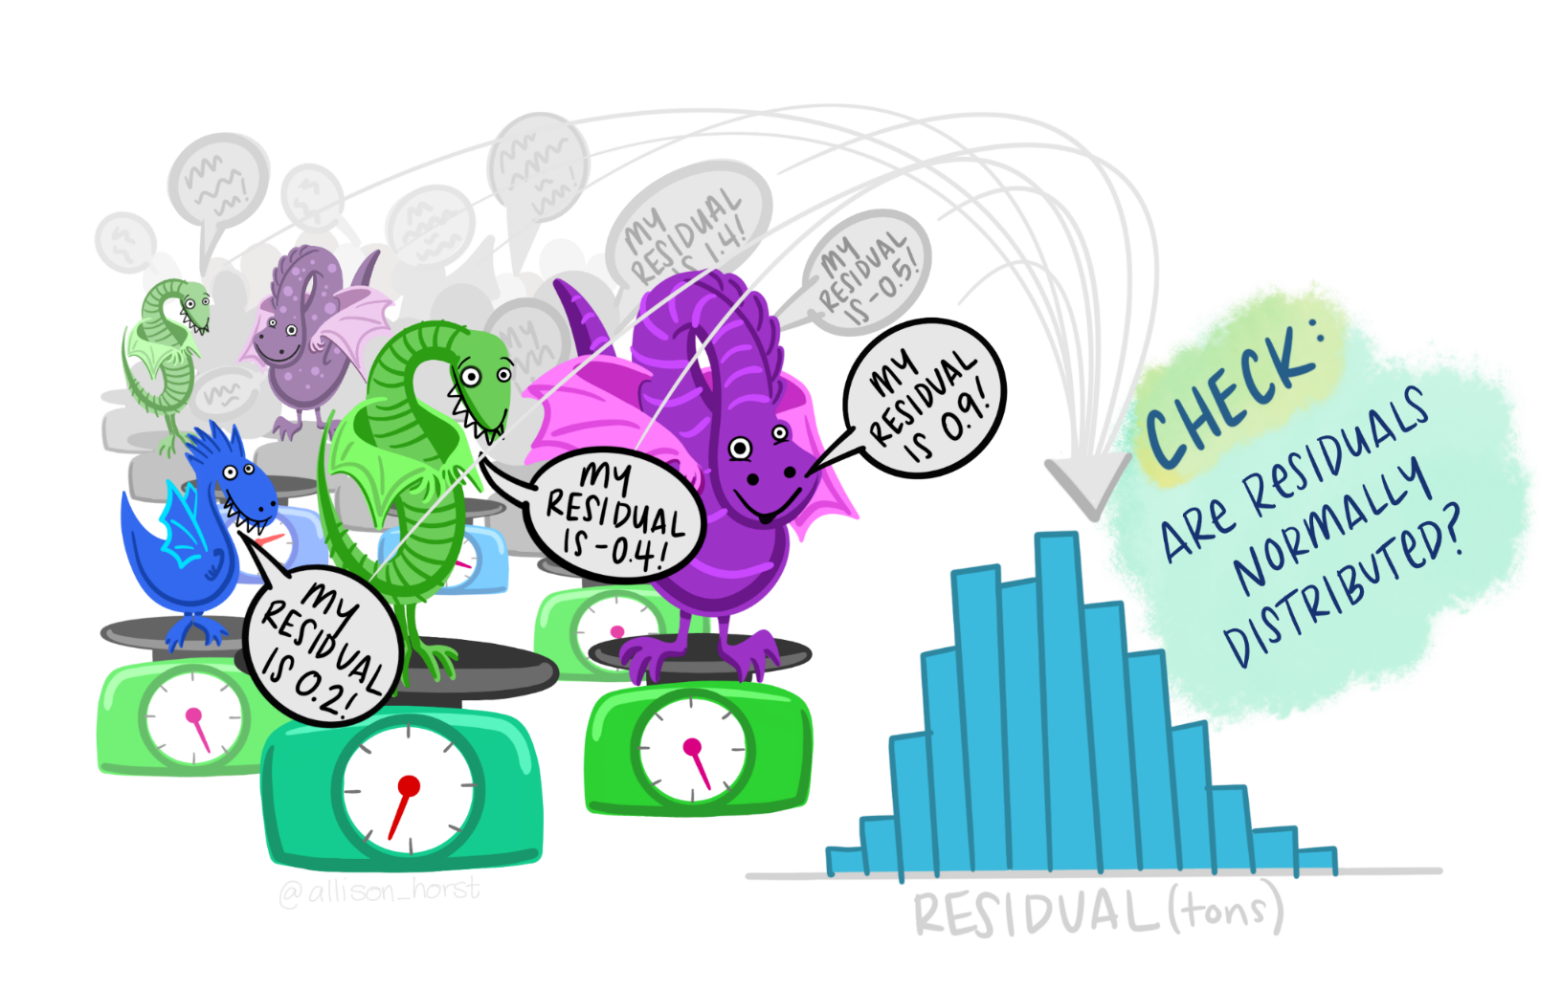
Assumptions: Normality of the residuals
Dragons: © Allison Horst

Slide 17
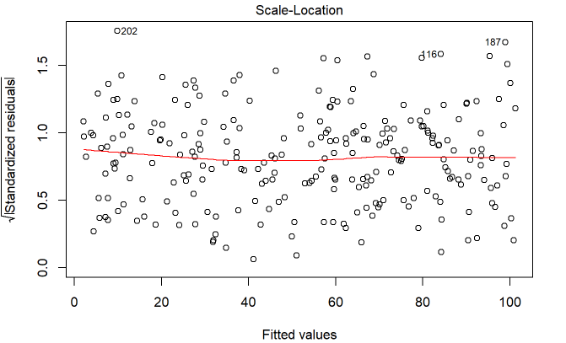
MLR Assumptions: Equality of variance

Slide 18
Multiple Linear Regression
Aim
To find a straight line to summarise the relationship between the dependent and independent variables
This line is the line of best fit that minimises the sum of the squared residuals
Best does not mean necessarily “good”

Slide 19
Your turn using the CSEW teaching data set
Dependent variable:
Effectx: Effectiveness of Criminal Justice System (high score= high opinion) [Derived from cjspolb cjscpsb cjscrt2a cjscrt2b cjsps1b cjsps2b]
Cjspolb: How confident are you that the police are effective at catching criminals? (Module A and B)
Cjscpsb: How confident are you that the Crown Prosecution Service is effective at prosecuting people accused of committing a crime? (Module A and B )
Cjscrt2a: How confident are you that the Courts are effective at dealing with cases promptly? (Module A and B )
Cjscrt2b: How confident are you that the Courts are effective at giving punishments which fit the crime? (Module A and B)
Cjsps1b: How confident are you that prisons are effective at punishing offenders who have been convicted of a crime? (Module A and B)
Cjsps2b: How confident are you that prisons are effective at rehabilitating offenders who have been convicted of a crime? (Module A and B )

Slide 20
References
OECD (2017), “Effectiveness and fairness of judicial systems”, in Government at a Glance 2017, OECD Publishing, Paris. (DOI: https://doi.org/10.1787/gov_glance-2017-91-en)
Sentencing Council (2019). Public knowledge of and confidence in the Criminal Justice System and Sentecing. Retrieved online 28/01/2020: https://www.sentencingcouncil.org.uk/wp-content/uploads/Public-Knowledge-of-and-Confidence-in-the-Criminal-Justice-System-and-Sentencing.pdf
Jansson, K. (2015). Public confidence in the Criminal Justice System – findings from the Crime Survey for England and Wales (2013/14). Retrieved online 28/01/2020: https://assets.publishing.service.gov.uk/government/uploads/system/uploads/attachment_data/file/449444/public-confidence.pdf
Field et al (2013). Discovering Statistics Using R. Sage Publications
Gelman, A: Hill, J. (2007) Data Analysis using regression and multilevel/hierarchical models. Cambridge University Press.

Slide 21
Ana Morales-Gomez
ana.morales@manchester.ac.uk
To follow UK Data Service on Twitter:
@UKDataService

